Slide 1


One Texas Monthly Update
June 2026

Slide 2
Agenda
1. Review current measures
2. Regional account focus
3. Initiative updates
4. Calendar planning
5. Discussion

Slide 3
Personal Measures
Large accounts ($2M+) that have doubled: 0
Medium accounts ($750K+) that have doubled: 0
New Anchors from pursuit: 0
New Key from pursuit (stretch): 0
Partner Co-sell influenced: $0
C-Suite connections added
Awareness 1: 12
Awareness 2: 2
Awareness 3: 0
Awareness 4+: 0
Speaking Engagements Completed: 4

Slide 4
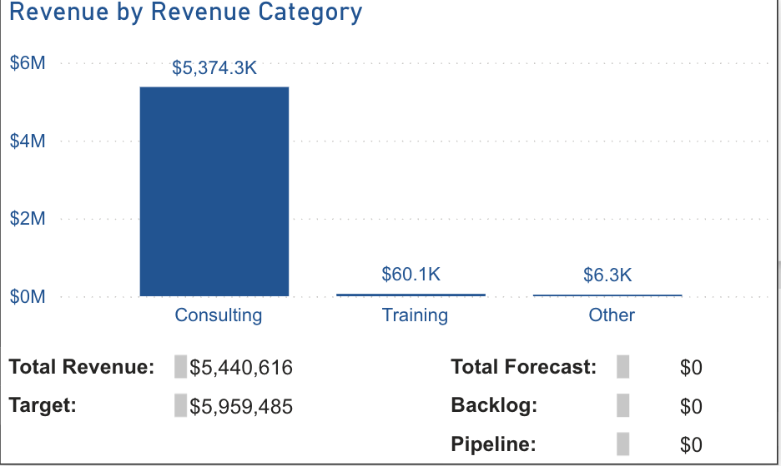
Measures
One Texas Q2 Revenue vs. Target: -11%
Dallas Q2 vs. Target: +2%
South Texas Q2 vs. Target: -24%
May Monthly Revenue: Dallas $2.73M | South Texas $3.02M | OTX $5.75M
Partner Co-sell Pipeline: $50K pipeline | Won: $332K (** verify w/ Sales Ops)
New Logos YTD (May): 7 OTX (Dallas 6 | STX 1 — watch)
New Anchors YTD (May): 2 of 3 annual target — on pace
90-Day Weighted Pipeline (Rock 1): South Texas 74% | Dallas 95%
Speaking Completed (YTD): update manually

Slide 5
Regional Account Focus
Autodesk
Insperity
Intuit
PriceSmart
Siemens
Marriott
Kirby Corp
Expedia
Masimo
Constellation
McKesson
7-Eleven
Wendy’s
Schwab
ORIX
AT&T
Builders First Source
CBRE
Tenet
Texas Instruments

Slide 6
Initiative Updates
Dallas Wins
Q2 YTD: 6 logos (Ways2Well, Simpson Strong-Tie + 4 more)
Dallas Q2 revenue +2% vs. target – holding green
90-day forecast at 95% – on track
Dallas Challenges
Anchor pursuit behind – 0 of 3 annual target (Dallas)
Co-sell pipeline data integrity issue – verify with Sales Ops
South Texas Wins
Q2 YTD: 1 logo — significant drop from Q1
Siemens anchor (Houston) + 1 more = 2 of 3 OTX annual target
South Texas Challenges
Q2 revenue -24% vs. target – accelerating deterioration
90-day forecast only 74% – gap not closing this quarter
Houston primary driver (-25% CQ vs. target)
One Texas
Convergence AI + DRC events driving pipeline coverage
“The Improving Edge” Podcast – episodes in progress

Slide 7
Partner Momentum
Microsoft + Confluent Co-Sell Pipeline — June 2026
Partner / Seller | Improving Seller | Account(s) | Status / Next Step
Rob Ogbah Strategic AE | David O’Hara | CBRE | CBRE in pipeline — PS engagement planned Confluent pipeline: $785K (2 opps, 0 closed)
Arean Asgariani Sr. Enterprise AE | Diana Stevens VP Sales | American Airlines | 3-way meeting completed Microsoft $1.64M pipeline (3 opps, 1 win $332K)
Kevin Collin Sr. Enterprise AE | Diana Stevens VP Sales | McKesson Toyota | McKesson — active Q3 pursuit Toyota — Cloud/AI proposal in progress
David Nanson & Surain Asokaraj | Stephen Johnson VP Sales | NRG Halliburton | NRG — AI SDLC proposal advancing Halliburton — POC ongoing
Stuart Maynard Enterprise AE | Stephen Johnson VP Sales | Insperity | Insperity — active engagement, Q3 pursuit Confluent relationship active
Dante Lanza Regional Sales Dir | David/Ehren/Nick | Account Review | Account review complete Next: Q3 activation planning

Slide 8
Calendar
One Texas Monthly Meeting
June 26, 2026
Microsoft AI Tour – Houston
Houston – completed May 28
Convergence AI
Dallas – completed March 30-31
Q3 One Texas Planning
Dallas + Houston – July TBD
DRC Executive Workshop
Dallas – Q3 TBD
Speaking Engagements
Update manually – 10 target for year
CEO Breakfast Roundtable
Dallas – Q3 TBD

Slide 9
Showcase
Q2 Revenue Review — One Texas Scorecard

Slide 10
Sales Updates
90-Day Weighted Pipeline (Rock 1)
Dallas: 95% of forecast – on track
South Texas: 74% – below 90% threshold, gap not closing
New Logos YTD (Q1)
Dallas: 6 logos YTD (Ways2Well, Simpson Strong-Tie + 4 more)
South Texas: 1 logo YTD — WATCH | One Texas: 7 logos YTD
New Anchors: 2 of 3 annual (Siemens Houston + 1) — ON PACE
Partner Co-Sell (Rock 4)
Microsoft: $50K pipeline | $332K won (1 opp)
Confluent: $785K pipeline (2 opps, 0 closed) – as of June 9
** June 22 data shows anomaly – verify with Sales Ops before meeting
Discussion
South Texas recovery plan – Q3 actions
Anchor pursuit acceleration (2 remaining of 3 annual)
Co-sell pipeline data integrity – next steps

